Slide 1
Boot Sequence

Slide 2
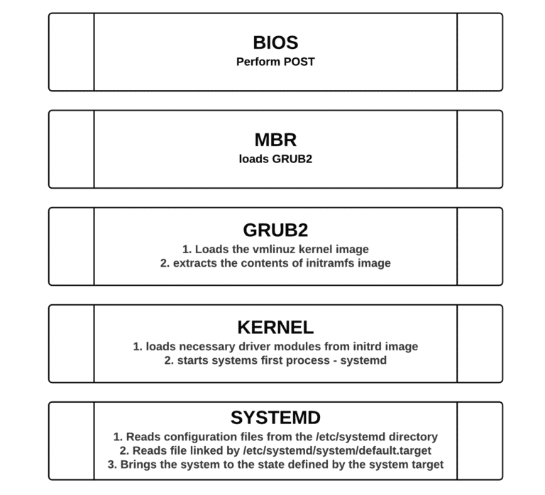
Introduction
It is important to understand the Linux boot process to troubleshoot boot problems.

Slide 3
BIOS
The BIOS (Basic Input/Output System)
  performs the POST (power on self test) to detect, test and initialize system hardware components.
  Loads the MBR (Master boot record).

Slide 4

Master boot record (MBR)
Master Boot Record (MBR) is the first 512 bytes of the boot drive that is read into memory by the BIOS.
  The first 64 bytes contain the partition table for the disk.
  The last two bytes are the “Magic Number” which is used for error detection.
  MBR discovers the bootable device and loads the GRUB2 boot loader into memory and transfers control over to it.

Slide 5
GRUB2 Bootloader
The default bootloader program used on RHEL 7 is GRUB 2.
GRUB stands for GRand Unified Bootloader.
  The GRUB 2 configuration file is located at /boot/grub2/grub.cfg (Do not edit this file directly).
  GRUB 2 menu-configuration settings are taken from /etc/default/grub when generating grub.cfg.

Slide 6
GRUB2 Bootloader Cont.
Sample /etc/default/grub file :
GRUB_TIMEOUT=5
GRUB_DISTRIBUTOR="$(sed 's, release .*$,,g' /etc/system-release)"
GRUB_DEFAULT=saved
GRUB_DISABLE_SUBMENU=true
GRUB_TERMINAL_OUTPUT="console"
GRUB_CMDLINE_LINUX="crashkernel=auto rhgb quiet"
GRUB_DISABLE_RECOVERY="true"
If changes are made to any of these parameters, you need to run grub2-mkconfig to re-generate the /boot/grub2/grub.cfg file.
  # grub2-mkconfig –o /boot/grub2/grub.cfg

Slide 7
GRUB2 Bootloader Cont.
GRUB2 searches the compressed kernel image file also called as vmlinuz in the /boot directory.
GRUB2 loads the vmlinuz kernel image file into memory and extracts the contents of the initramfs image file into a temporary, memory-based file system (tmpfs).
The initial RAM disk (initrd) is an initial root file system that is mounted before the real root file system.

Slide 8
GRUB2 Bootloader Cont.
The job of the initial RAM file system is to preload the block device modules, such as for IDE, SCSI, or RAID, so that the root file system, on which those modules normally reside, can then be accessed and mounted.
The initramfs is bound to the kernel and the kernel mounts this initramfs as part of a two-stage boot process.
  The dracut utility creates initramfs whenever a new kernel is installed.
  Use the lsinitrd command to view the contents of the image created by dracut

Slide 9
Kernel
The kernel starts the systemd process with a process ID of 1 (PID 1)

Slide 10
systemd
systemd is the parent of all processes on a system.
It reads the file linked by /etc/systemd/system/default.target (for example, /usr/lib/systemd/system/multi-user.target) to determine the default system target (equivalent to run level).
The system target file defines the services that systemd starts.

Slide 11
Systemd cont
systemd brings the system to the state defined by the system target, performing system initialization tasks such as:
  Setting the host name
  Initializing the network
  Initializing SELinux based on its configuration
  Printing a welcome banner
  Initializing the system hardware based on kernel boot arguments
  Mounting the file systems, including virtual file systems such as the /proc file system
  Cleaning up directories in /var
  Starting swapping

Slide 12
systemd target units
Target units have a .target extension.
Target units allow you to start a system with only the services that are required for a specific purpose.
To list the predefined systemd run level target units :
find / -name "runlevel*.target"
/usr/lib/systemd/system/runlevel4.target
/usr/lib/systemd/system/runlevel5.target
/usr/lib/systemd/system/runlevel6.target
/usr/lib/systemd/system/runlevel1.target
/usr/lib/systemd/system/runlevel2.target
/usr/lib/systemd/system/runlevel3.target
/usr/lib/systemd/system/runlevel0.target

Slide 13
systemd target units cont.
Target Units | Description
runlevel0.target, poweroff.target | Shut down and power off
runlevel1.target, rescue.target | Set up a rescue shell
runlevel[234].target, multi- user.target | Set up a nongraphical multi-user shell
runlevel5.target, graphical.target | Set up a graphical multi-user shell
runlevel6.target, reboot.target | Shut down and reboot the system

Slide 14
systemd target units cont.
To view which target unit is used by default use :
# systemctl get-default
multi-user.target
Notice that the default.target symbolic file points to graphical.target file.
# ls -l /etc/systemd/system/default.target
lrwxrwxrwx. 1 root root 40 Oct 11 02:02 /etc/systemd/system/default.target -> /usr/lib/systemd/system/graphical.target

Slide 15
systemd target units cont.
To change the default target unit to the graphical.target unit
# systemctl set-default graphical.target
rm '/etc/systemd/system/default.target'
ln -s '/usr/lib/systemd/system/graphical.target' '/etc/systemd/system/default.target'
To change currently active target
# systemctl isolate multi-user.target

Slide 16
Services

Slide 17
To Start and Stop
Services
Start a service
# systemctl start [service_name]
Example
  # systemctl start network
Stop a service:
  # systemctl stop [service_name]
Example:
  # systemctl stop network

Slide 18
To Check status of a service
# systemctl status [service_name]
Example
# systemctl status network

Slide 19
Enabling or disabling auto-start of a service
Enable auto-start a service at boot):
# systemctl enable [service_name]
Example:
# systemctl enable network
Disable auto-start a service at boot:
# systemctl disable [service_name]
Example:
# systemctl disable network

Slide 20
Listing services
List enabled/disabled status of all installed service units:
# systemctl list-unit-files --type service

Slide 21
Scheduling and Processes

Slide 22
Task automation
Red Hat Enterprise Linux provides two utilities to manipulate and schedule tasks
  The at service
    Executes a task at a specific time
    Uses the at command to set up the execution of a task
    Is administered by the atd daemon
  The cron service
    Executes tasks at scheduled intervals.
    Uses the crontab command to set up the execution of a task.
    Is administered by the crond daemon

Slide 23
Access to the at command
/etc/at.allow and /etc/at.deny files restrict or allow users to run the at command.
If /etc/at.allow exists and your username appears in it, you may use at command.
If /etc/at.allow does not exist and /etc/at.deny does, then you must not be listed in /etc/at.deny to use at.
If neither file exists, all users are denied to schedule jobs with at.
The default installation supplies an empty at.deny file, thereby allowing the use of at to all users.

Slide 24
Use cron for task automation
Crontab files are stored in /var/spool/cron
Avoid modifying these files directly, use crontab –e command
The cron file format
Min(0-59) Hours(0-23) Day(1-31) Month(1-12) Day(0-7) command
Example
30 6 * * 0 /home/rania/mys1
Notes:
From 5 to 10
5-10
Jan and Feb
1,2
Every 20 min.
*/20

Slide 25
The /etc/anacrontab File
It automates the execution of system tasks. These tasks are often vital for the integrity of the operating system.
  # cat /etc/anacrontab
  SHELL=/bin/bash
  PATH=/sbin:/bin:/usr/bin:/usr/sbin
  MAILTO=root
  HOME=/
#period in days delay in minutes job-identifier command
  1 5 cron.daily nice run-parts /etc/cron.daily
  7 25 cron.weekly nice run-parts /etc/cron.weekly
  @monthly 45 cron.monthly nice run-parts /etc/cron.monthly

Slide 26
Managing System Logs

Slide 27
Introduction
The rsyslog system messaging features track system activities and events.
Log messages can be manually generated using logger command

Slide 28
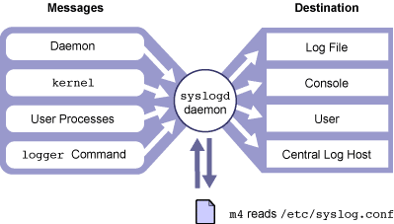
How rsyslogd Works ?

Slide 29
rsyslogd Configuration
File
/etc/rsyslog.conf file
  Selector
    Facility: category of system processes that generate the messages
      Example: kern, mail, daemon, cron, local0-7, *, …
    Level: severity or importance of the message
      Example: emerg, alert, crit, err, warning,…
  Action: where to send a message
    Example: /pathname, @hostname, username, *
      /pathname must already be exist

Slide 30
Monitoring a rsyslog File in Real Time
You can monitor the designated rsyslog file in real time using the command tail -f.
The tail -f command holds the file open so that you can view messages being written to the file by the syslogd daemon.
tail -f /var/adm/messages
jun 14 13:15:39 host1 inetd[2359]:[ID 317013 daemon.notice] telnet [ 2361] from 192.9.200.1 45800
Time/Date localhostname Pname[pid] MSG ID facility.level incoming request [ppid] IP Port name

Slide 31
Adding One-Line Entries to a System Log File
The logger command enables you to send messages to the rsyslogd daemon.
A system administrator can write administrative shell scripts that report the status of backups, or other functions by using the logger command.

Slide 32
Adding One-Line Entries to a System
Log File Cont'd
logger [ -i ] [ -f file ] [ -p priority ] [ -t tag ] [ message ]
Option | Description
-i | Logs the process Id of the logger command with each line
-f filename | Uses the content of the file as the message body
-p priority | Enters the message with the specified priority, the default is user.notice

Slide 33
Identify system log files
The /var/log/dmesg file
  Kernel log messages.
  This log file is written after system boot.
  It contains messages from the kernel that were generated during the boot process.
The /var/log/messages file
  It the standard system log file.
  It contains messages from most of your system’s services.

Slide 34
Identify system log files cont’d
The /var/log/maillog file
  Mail system messages
  It contains messages and errors from your mail service
The /var/log/secure file
  It contains messages and errors from security-related services such as login, network connections (xinetd)
  Very useful in detecting and investigating attempts to gain unauthorized access to the system.

Slide 35
Maintaining logs
Left unchecked, system logs will grow until you run out of disk space.
Red Hat Enterprise Linux provides logrotate, a powerful tool for log file maintenance.
Log files are rotated at predefined intervals.
logrotate can be configured to compress old log files to conserve filesystem space.

Slide 36
Maintaining logs cont’d
Example
  /var/log/messages is rotated weekly to /var/log/messages.1, with older log files rotated to /var/log/messages.2, etc.
  Generally, four weeks of log files are kept; older rotated files are deleted.
When you install a new system service by Red Hat Package Manager (RPM) that generates its own log file, it should "pre-configure" itself automatically for log file rotation by placing a configuration file in the /etc/logrotate.d directory.

Slide 37
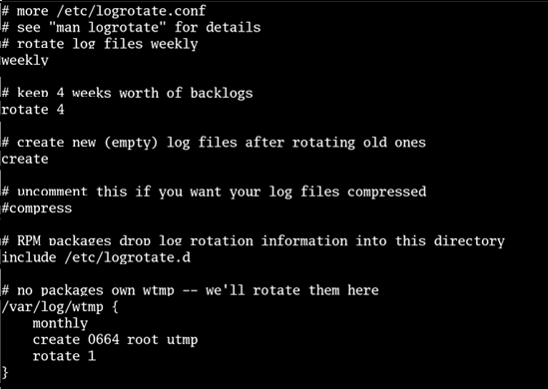
A sample of logrotate.conf File

Slide 38
Maintaining Logs
Monitoring system logs is an onerous but important task.
If you do not properly monitor your logs, you might miss
  Security problems
  Hardware problems
  Software problems

Slide 39
Maintaining Logs cont’d
The logwatch utility, can be installed, parses log files and generates a report that can either be printed or sent to a user via e-mail.
By default, logwatch runs nightly as a result of the 00-logwatch script located in the /etc/cron.daily directory. The result of this nightly execution is a report e-mailed to the root user.
The logwatch utility can be configured to detect almost any type of activity with the /etc/logwatch/conf/logwatch.conf file.
* See /usr/share/doc/logwatch-version (where version is the version of logwatch that you are using) for information on writing log filters.

Slide 40
Installing and Managing software
RPM
Yum

Slide 41
Introduction to yum command
Yum is a powerful command-line tool that can be used to
  Install
  Update
  Remove
  And query software packages
Yum is automatically configured to use Red Hat repository when you register your machine, but still you can configure yum to get packages from third-party package repositories over the network

Slide 42
Basic yum Commands
To display usage information
  yum help
To display installed and available packages
  yum list
To list packages by keywords
  yum search KEYWORD
To display detailed information about a package
  yum info PACKAGENAME

Slide 43
Basic yum Commands Cont'd
To obtain and install a software package, including dependencies
  yum install PACKAGENAME
To remove an installed software package, including any supported packages
  yum remove PACKAGENAME
To obtain and install a newer version of software package, including any dependencies
  yum update PACKAGENAME
To display the packages that match pathname specified
  yum provides PATHNAME
To install local packages files
  yum localinstall PACKAGEFILE.rpm

Slide 44
Introduction to RPM
Package installation is never interactive
No such thing as a patch
The local RPM database is maintained in /var/lib/rpm
Package name: name-version-release .architecture.rpm

Slide 45
RPM Package Manager
RPM components
  Local Database
    In /var/lib/rpm
    Stores information about installed packages such as file attributes and package prerequisites
  rpm and related executable
    Compressed archives of files and associated dependency information.
  Package files
    Package files named name-version-release.architecture.rpm
      Version refers to the open source version of the project
      Release refers to Red Hat internal patches to the open source code.

Slide 46
RPM Package Manager cont’d
Primary Functions
  Install
  Upgrade
  Remove
  Query
  Verify

Slide 47
Install Software
When installing an rpm package, rpm will consult the local database to ensure that
  Any prerequisites are installed on the system
  Installing the rpm will not clobber any preexisting files.
To install software
  –i or --install option
To omit the dependency check
  --nodeps option
To omit the replacement check
  --replacement option
To omit both checks
  --force option

Slide 48
Installing Software cont’d
Example
  # rpm -i zip-2.5-8.i386.rpm
Useful options
  -v option
    Print package name
  -h option
    Print hash marks

Slide 49
Upgrading Software
The original package will be removed except the configuration files.
Configuration files from the original installation are saved with .rpmsave extension.
To upgrade software
  -U option
Freshening software
  -F option
* What is the different between upgrade and freshening ??

Slide 50
Uninstalling Software
To remove software
  -e or --erase option
Example
# rpm -ihv zip-2.3-8.386.rpm
# rpm -e zip
* The package argument must be the installed package’s name, not the package file name.

Slide 51
Query Software
Query options fall into one of two categories
  Specify which packages to query.
  Specify what information to retrieve.
To list all installed packages
  # rpm -qa
To display the name including the version and release of a specific package
  # rpm –q pkg-name

Slide 52
Query Software cont’d
To display a package information
  # rpm -qi pkg-name
To list files contained in a package
  # rpm -ql pkg-name
To display the package name that owns a certain file
  # rpm -qf filename
To display package prerequisites
  # rpm -q --requires pkg-name

Slide 53
RPM Verification
Verifying an installed package compares the file sizes, permissions, type, owner, group, checksum and modification time against RPM database.
Any inconsistencies will be reported.
An installed package can also be verified against a package file

Slide 54
RPM Verification cont’d
To verify an installed package against the RPM database
  # rpm -V pkgname
To verify all installed RPMs against the RPM database
# rpm -Va
To verify installed package against a given package file
# rpm -Vp pkg-name

Slide 55
Using Third-Party Repositories
Third-party repository are network-accessible of software package files which can be accessed by yum
Put file in /etc/yum.repos.d directory to enable support for new third-party repository.
Example of /etc/yum.repos.d/*.repo configuration
[Myrepo]
name= my repository
baseurl=file:///media/...
gpgcheck=0

Slide 56
Thanks :)

